Slide 1
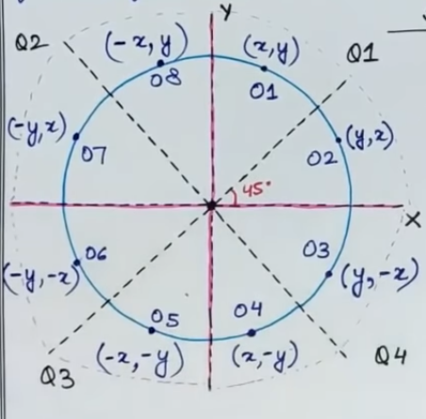
Mid Point Circle Drawing Algorithm
A circle is a set of all points that lie at an equal distance(radius) from a fixed point called centre.
Symmetric Figure:
8-way symmetry :
OCTANTS
NOTE:
CIRCLE- 1
SEMI CIRCLE – ½
QUADRANT – ¼
OCTANT – 1/8

Slide 2
Mid Point Circle Drawing Algorithm
Procedure-
Given-
Centre point of Circle = (X₀, Y₀)
Radius of Circle = R
The points generation using Mid Point Circle Drawing Algorithm involves the following steps-

Slide 3
Step-01:
Assign the starting point coordinates (X₀, Y₀) as-
X₀ = 0
Y₀ = R
Starting coordinate(0,R)
Step-02:
Calculate the value of initial decision parameter P₀ as-
P₀ = 1 – R

Slide 4
Step-03:
Suppose the current point is (X_{k}, Y_{k}) and the next point is (X_{k+1}, Y_{k+1}).
Find the next point of the first octant depending on the value of decision parameter P_{k}.
Follow the below two cases-

Slide 5
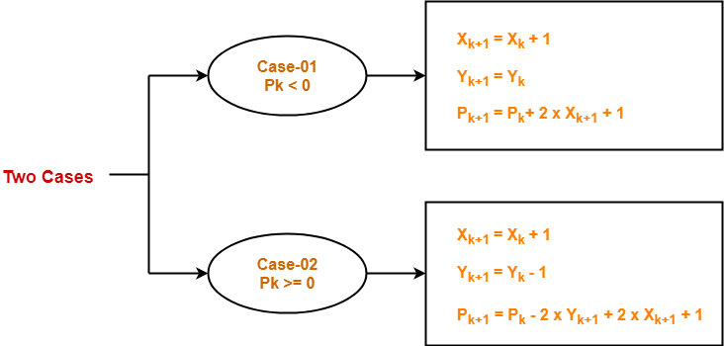

Slide 6
Step-04:
If the given centre point (X₀, Y₀) is not (0, 0), then do the following and plot the point-
X _{plot} = X_{c} + X₀
Y _{plot} = Y_{c} + Y₀
Here, (X_{c}, Y_{c}) denotes the current value of X and Y coordinates.

Slide 7
Step-05:
Keep repeating Step-03 and Step-04 until X _{plot} >= Y _{plot}

Slide 8
Step-06:
Step-05 generates all the points for one octant.
To find the points for other seven octants, follow the eight symmetry property of circle.

Slide 9
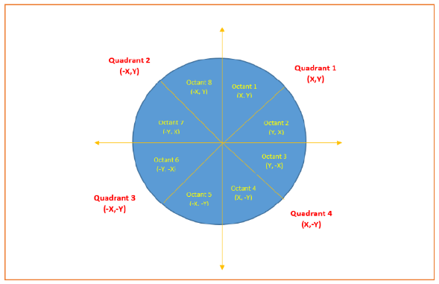
This is depicted by the following figure-

Slide 10
Problem-01:
Given the centre point coordinates (0, 0) and radius as 10, generate all the points to form a circle.
Solution-
Given-
Centre Coordinates of Circle (X₀, Y₀) = (0, 0)
Radius of Circle = 10

Slide 11
Step-01:
Assign the starting point coordinates (X₀, Y₀) as-
X₀ = 0
Y₀ = R = 10

Slide 12
Step-02:
Calculate the value of initial decision parameter P₀ as-
P₀ = 1 – R
P₀ = 1 – 10
P₀ = -9

Slide 13
Step-03:
As P_{initial} < 0, so case-01 is satisfied.
Thus,
X_{k+1} = X_{k} + 1 = 0 + 1 = 1
Y_{k+1} = Y_{k} = 10
P_{k+1} = P_{k} + 2 x X_{k+1} + 1 = -9 + (2 x 1) + 1 = -6

Slide 14
Step-04:
This step is not applicable here as the given centre point coordinates is (0, 0).
Step-05:
Step-03 is executed similarly until X_{k+1} >= Y_{k+1} as follows-

Slide 15
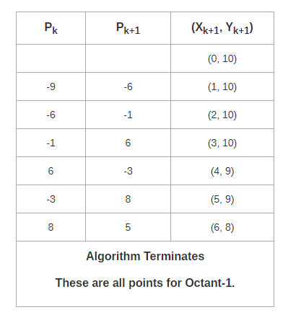

Slide 16
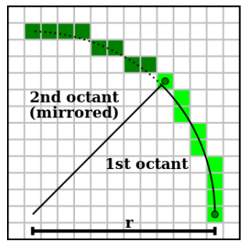

Slide 17
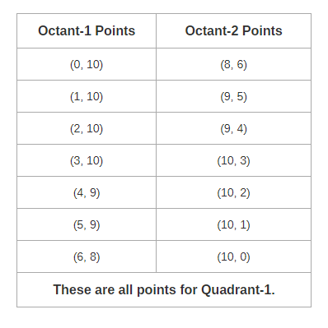
Algorithm calculates all the points of octant-1
and terminates.
Now, the points of octant-2 are obtained using the mirror effect by swapping X and Y coordinates.

Slide 18
Now, the points for rest of the part are generated by following the signs of other quadrants.
The other points can also be generated by calculating each octant separately.
Here, all the points have been generated with respect to quadrant-1

Slide 19
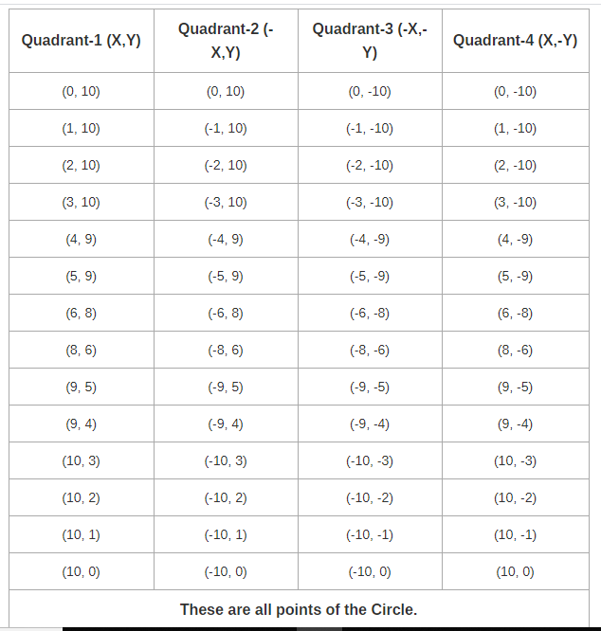

Slide 20
Problem-02:
Given the centre point coordinates (4, 4) and radius as 10, generate all the points to form a circle.
Solution-
Given-
Centre Coordinates of Circle (X₀, Y₀) = (4, 4)
Radius of Circle = 10
As stated in the algorithm,
We first calculate the points assuming the centre coordinates is (0, 0).
At the end, we translate the circle.

Slide 21
Step-01, Step-02 and Step-03 are already completed in Problem-01.
Now, we find the values of X_{plot} and Y_{plot} using the formula given in Step-04 of the main algorithm.
The following table shows the generation of points for Quadrant-1-
X_{plot} = X_{c} + X₀ = 4 + X₀
Y_{plot} = Y_{c} + Y₀ = 4 + Y₀

Slide 22
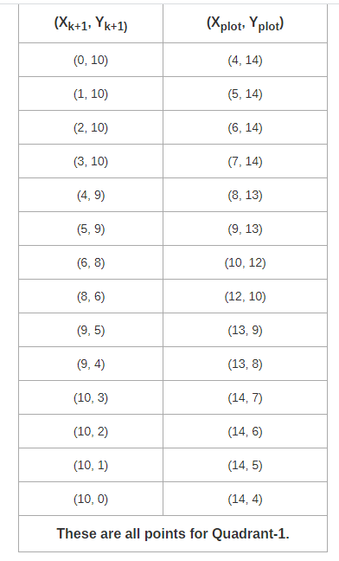

Slide 23
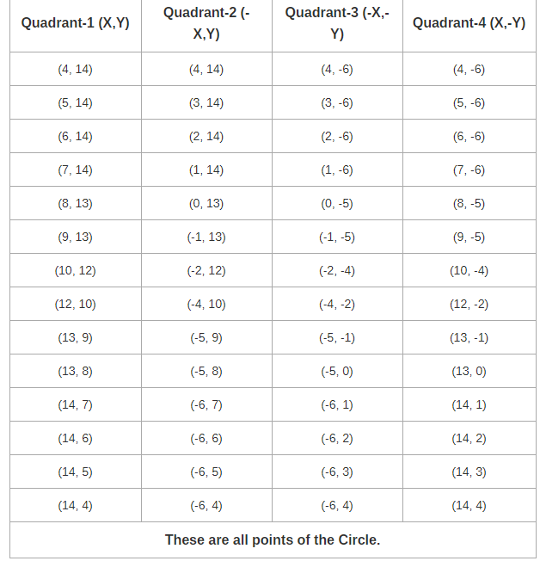
The following table shows the points for all the quadrants-

Slide 24
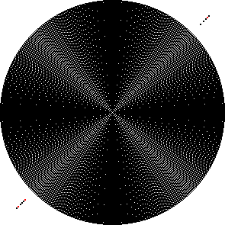
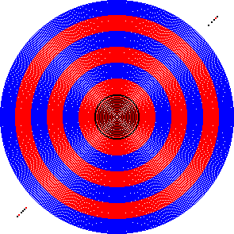
Sample Diagram
Two-hundred ninety five concentric circles drawn with the midpoint circle algorithm. On left, all circles are drawn black; on right, red, black and blue are used together to demonstrate the concentricity of the circles.

Slide 25
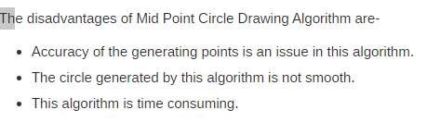
Disadvantages of Mid Point Circle Drawing Algorithm-

Slide 26
Advantages of Mid Point Circle Drawing Algorithm-
The advantages of Mid Point Circle Drawing Algorithm are-
It is a powerful and efficient algorithm.
The entire algorithm is based on the simple equation of circle X² + Y² = R².
It is easy to implement from the programmer’s perspective.
This algorithm is used to generate curves on raster displays.

Slide 27


